Slide 1

Python

Slide 2
Objectives
OOP vocabulary
Creation of a classification
Class attributes
__init__()
Class inheritance
The super() function
Exercises on OOP

Slide 3
OOP vocabulary

Slide 4

What is Object-Oriented Programming?
OOP is the dominant programming paradigm these days, having replaced the “structured,” procedural programming techniques that were developed in the 1970s.
An object-oriented program may thus be viewed as a collection of interacting objects, as opposed to the conventional model, in which a program is seen as a list of tasks (subroutines) to perform.

Slide 5
What is Object-Oriented Programming? (cont.)
In OOP, each object is capable of receiving messages, processing data, and sending messages to other objects.
Each object can be viewed as an independent 'machine' with a distinct role or responsibility. The actions (or "methods") on these objects are closely associated with the object.
An object-oriented program is made of objects. Each object has a specific functionality that is exposed to its users, and a hidden implementation.

Slide 6
OOP Consists of?
The concept of OOP focuses on creating reusable code.
This concept is also known as DRY (Don't Repeat Yourself).
Attributes
Examples are
name, age, color
behavior examples are
singing, dancing

Slide 7

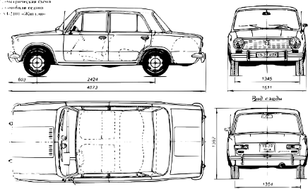
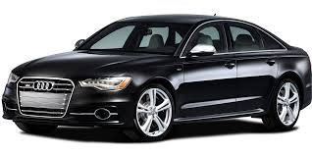

Class
Object
There may be thousands of other cars in existence.
Each car was built from the same set of blueprints.
In object-oriented terms, we say that your car is an instance of the class of objects known as cars.
Class & Object
Notes:
is the most effecient way to modules your project where you have
1- Class
is the template that modulize your code which represent the real-world things and situation where class has the element and behavior.
2- Object
the instance that you can define or clone from the class template having the behavior that you define in the class

Slide 8
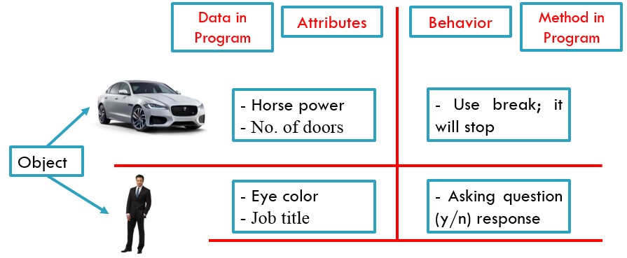
OOP (Real-World Modeling)
Notes:
When understanding the meaning of the class and object you can reflect this on the life around us (provide real-world Examples like football game where all payer have the same properties and changing some thing like height, width, key play tricks )
provide some real example about the importance of using the Class and the value of the design approces

Slide 9
Creation of a classification

Slide 10
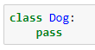
How to Define a Class
All class definitions start with the class keyword, which is followed by the name of the class and a colon. Any code that is indented below the class definition is considered part of the class’s body.
Here’s an example of a Dog class:

Slide 11
How to Define a Class (cont.)
The body of the Dog class consists of a single statement: the pass keyword. pass is often used as a placeholder indicating where code will eventually go. It allows you to run this code without Python throwing an error.
Python class names are written in Capitalized Words notation by convention
Notes:
Python class names are written in CapitalizedWords notation by convention. For example, a class for a specific breed of dog like the Jack Russell Terrier would be written as JackRussellTerrier.

Slide 12
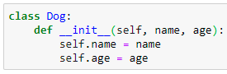
How to Define a Class (cont.)
The properties that all Dog objects must have are defined in a method called __init__()
You can give .__init__() any number of parameters, but the first parameter will always be a variable called self.
Notes:
Every time a new Dog object is created, .__init__() sets the initial state of the object by assigning the values of the object’s properties. That is, .__init__() initializes each new instance of the class.
When a new class instance is created, the instance is automatically passed to the self parameter in .__init__() so that new attributes can be defined on the object.
Notice that the .__init__() method’s signature is indented four spaces. The body of the method is indented by eight spaces. This indentation is vitally important. It tells Python that the .__init__() method belongs to the Dog class.
In the body of .__init__(), there are two statements using the self variable:
self.name = name creates an attribute called name and assigns to it the value of the name parameter.
self.age = age creates an attribute called age and assigns to it the value of the age parameter.

Slide 13
Class attributes __init__()

Slide 14
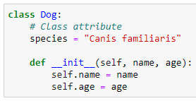
instance attributes / class attributes
Attributes created in .__init__() are called instance attributes.
Attributes created outside of .__init__(). are called class attributes.
Notes:
Attributes created in .__init__() are called instance attributes. An instance attribute’s value is specific to a particular instance of the class. All Dog objects have a name and an age, but the values for the name and age attributes will vary depending on the Dog instance.
On the other hand, class attributes are attributes that have the same value for all class instances. You can define a class attribute by assigning a value to a variable name outside of .__init__().
For example, the following Dog class has a class attribute called species with the value "Canis familiaris":
Class attributes are defined directly beneath the first line of the class name and are indented by four spaces. They must always be assigned an initial value. When an instance of the class is created, class attributes are automatically created and assigned to their initial values.
Use class attributes to define properties that should have the same value for every class instance. Use instance attributes for properties that vary from one instance to another.

Slide 15
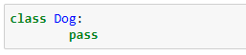
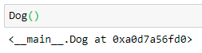
Instantiate an Object in Python
This creates a new Dog class with no attributes or methods.
You can instantiate a new Dog object by typing the name of the class, followed by opening and closing parentheses:.
Notes:
You now have a new Dog object at 0x106702d30. This funny-looking string of letters and numbers is a memory address that indicates where the Dog object is stored in your computer’s memory. Note that the address you see on your screen will be different.

Slide 16
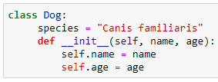
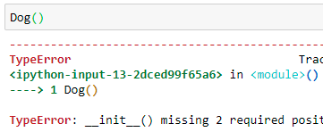
Class and Instance Attributes
Now create a new Dog class with a class attribute called .species and two instance attributes called .name and .age:
you need to provide values for the name and age. If you don’t, then Python raises a TypeError:

Slide 17
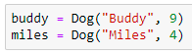
Pass Arguments to Instance Attributes
To pass arguments to the name and age parameters, put values into the parentheses after the class name:
two new Dog instances:
1- one for a nine-year-old dog named Buddy
2- one for a four-year-old dog named Miles.

Slide 18
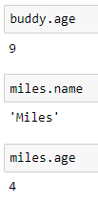
Access Instance’s Attributes
After you create the Dog instances, you can access their instance attributes using dot notation:

Slide 19
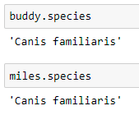
Access Class’s Attributes
You can access class attributes the same way:

Slide 20

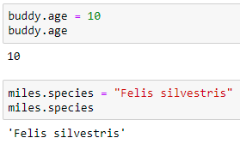
Advantages of Using Classes to Organize Data
Instances are guaranteed to have the attributes you expect
The values of attributes can be changed dynamically
Notes:
One of the biggest advantages of using classes to organize data is that instances are guaranteed to have the attributes you expect. All Dog instances have .species, .name, and .age attributes, so you can use those attributes with confidence knowing that they will always return a value.
Although the attributes are guaranteed to exist, their values can be changed dynamically:

Slide 21
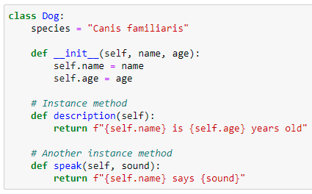
Instance Methods
Instance methods are functions that are defined inside a class and can only be called from an instance of that class.
Just like .__init__(), an instance method’s first parameter is always self.
Notes:
This Dog class has two instance methods:
.description() returns a string displaying the name and age of the dog.
.speak() has one parameter called sound and returns a string containing the dog’s name and the sound the dog makes.

Slide 22
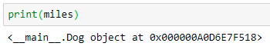
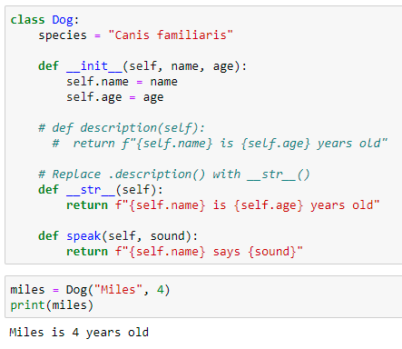
__str__()
This method returns the string representation of the object.
This method is called when print() or str() function is invoked on an object.
This method must return the String object.
Notes:
>>> print(miles)
<__main__.Dog object at 0x00aeff70>
When you print(miles), you get a cryptic looking message telling you that miles is a Dog object at the memory address 0x00aeff70. This message isn’t very helpful. You can change what gets printed by defining a special instance method called .__str__().

Slide 23
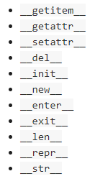
Dunder Methods
Methods like .__init__() and .__str__() are called dunder methods because they begin and end with double underscores.
There are many dunder methods that you can use to customize classes in Python.

Slide 24
Class inheritance

Slide 25
Inherit From Other Classes in Python
Inheritance is the process by which one class takes on the attributes and methods of another.
child classes
parent classes
Newly formed classes
the classes that
child classes
are derived from

Slide 26
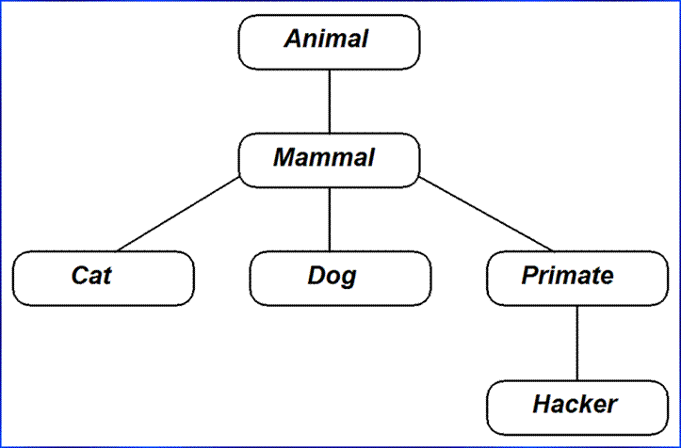
Child classes
Child classes can override or extend the attributes and methods of parent classes.
Child classes inherit all of the parent’s attributes and methods but can also specify attributes and methods that are unique to themselves.

Slide 27
Child classes
override
extend
You may have inherited your hair color from your mother. It’s an attribute you were born with. Let’s say you decide to color your hair purple. Assuming your mother doesn’t have purple hair, you’ve just overridden the hair color attribute that you inherited from your mom.
You also inherit, in a sense, your language from your parents. If your parents speak English, then you’ll also speak English. Now imagine you decide to learn a second language, like German. In this case you’ve extended your attributes because you’ve added an attribute that your parents don’t have.

Slide 28
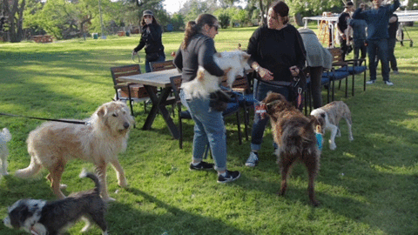
Dog Park Example
Pretend for a moment that you’re at a dog park. There are many dogs of different breeds at the park, all engaging in various dog behaviors.
Suppose now that you want to model the dog park with Python classes.

Slide 29
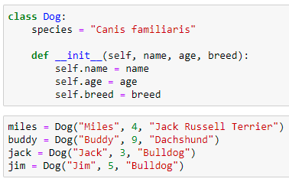
Dog Park Example - Solution
The Dog class we wrote before can distinguish dogs by name and age but not by breed.
We can add a .breed attribute:

Slide 30
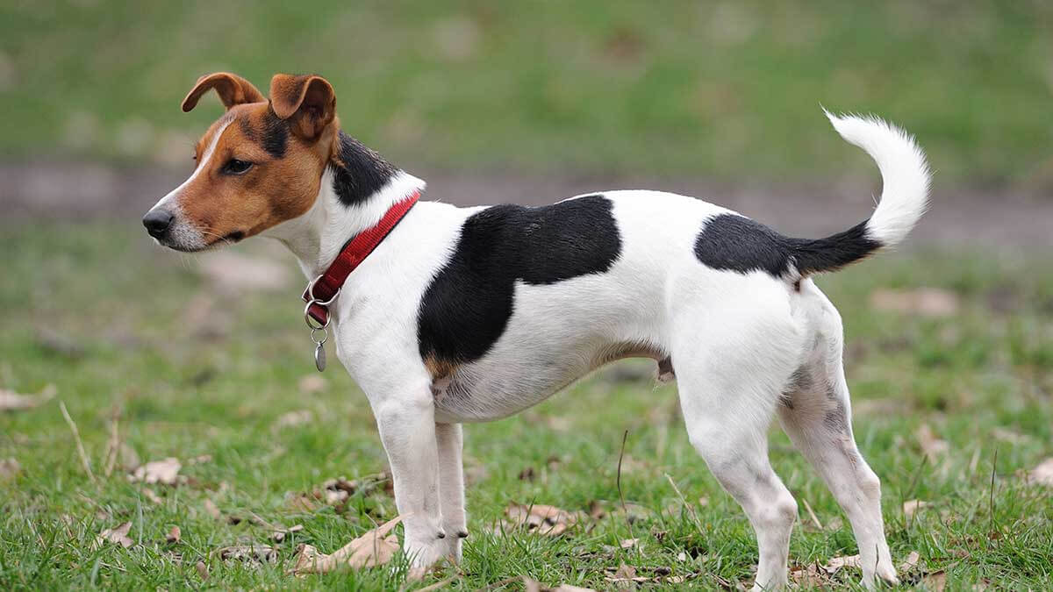


Dog Park Example - Solution
Each breed of dog has slightly different behaviors.
For example, bulldogs have a low bark that sounds like woof, but dachshunds have a higher-pitched bark that sounds more like yap.

Slide 31
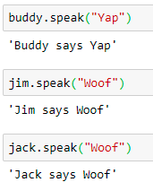
Dog Park Example - Solution
Using just the Dog class, you must supply a string for the sound argument of .speak() every time you call it on a Dog instance:
Notes:
Passing a string to every call to .speak() is repetitive and inconvenient. Moreover, the string representing the sound that each Dog instance makes should be determined by its .breed attribute, but here you have to manually pass the correct string to .speak() every time it’s called.

Slide 32
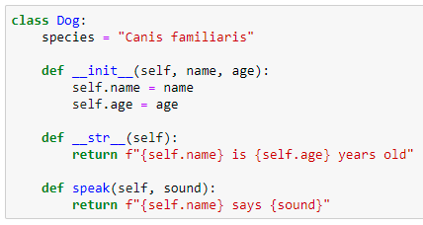
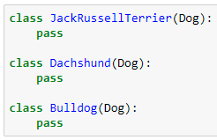
Dog Park Example – Solution Parent Classes vs Child Classes
Create a child class for each of the three breeds mentioned before:
1- Jack Russell Terrier,
2- Dachshund,
3- Bulldog.
Notes:
For reference, here’s the full definition of the Dog class: --- class Dog
Remember, to create a child class, you create new class with its own name and then put the name of the parent class in parentheses. Add the following to the dog.py file to create three new child classes of the Dog class:

Slide 33
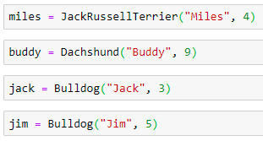
Dog Park Example – Solution Parent Classes vs Child Classes
Now you can instantiate some dogs of specific breeds.

Slide 34
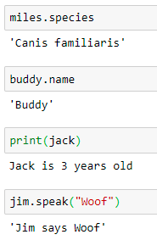
Dog Park Example – Solution Parent Classes vs Child Classes
Instances of child classes inherit all of the attributes and methods of the parent class

Slide 35
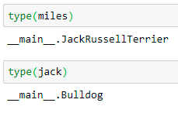
Dog Park Example – Solution Parent Classes vs Child Classes
To determine which class a given object belongs to, you can use the built-in type()

Slide 36
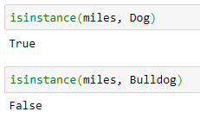
isinstance()
What if you want to determine if miles is also an instance of the Dog class? You can do this with the built-in isinstane():
Notes:
Notice that isinstance() takes two arguments, an object and a class. In the example above, isinstance() checks if miles is an instance of the Dog class and returns True.
The miles, buddy, jack, and jim objects are all Dog instances, but miles is not a Bulldog instance, and jack is not a Dachshund instance:

Slide 37
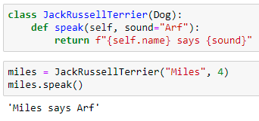
Extend the Functionality of a Parent Class
Since different breeds of dogs have slightly different barks, you want to provide a default value for the sound argument of their respective .speak() methods.
Notes:
Now that you’ve created child classes for some different breeds of dogs, let’s give each breed its own sound.
Barks ينبح
To do this, you need to override .speak() in the class definition for each breed.
To override a method defined on the parent class, you define a method with the same name on the child class. Here’s what that looks like for the JackRussellTerrier class:
Now .speak() is defined on the JackRussellTerrier class with the default argument for sound set to "Arf".
You can now call .speak() on a JackRussellTerrier instance without passing an argument to sound:

Slide 38
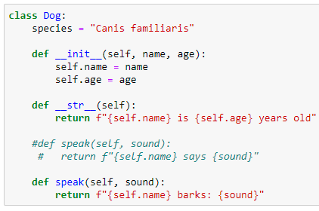
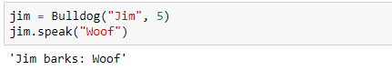
Inheritance
Changes to the parent class automatically propagate to child classes.
For example, change the string returned by .speak() in the Dog class
Notes:
This occurs as long as the attribute or method being changed isn’t overridden in the child class.

Slide 39
The super() function

Slide 40
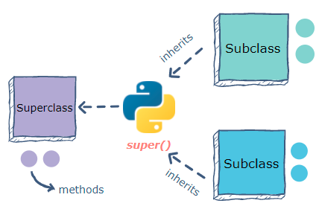
super()
The super() function in Python makes class inheritance more manageable and extensible.
The super() function has two major use cases:
To avoid the usage of the super (parent) class explicitly.
To enable multiple inheritances​.
https://www.educative.io/edpresso/what-is-super-in-python
Notes:
The function returns a temporary object that allows reference to a parent class by the keyword super.

Slide 41
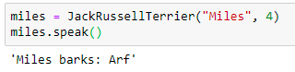
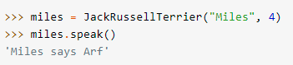
Dog Park Example – Solution (cont.)
Calling .speak() on a JackRussellTerrier instance won’t show the new style of output:
The expected output
The output
Notes:
Sometimes it makes sense to completely override a method from a parent class. But in this instance, we don’t want the JackRussellTerrier class to lose any changes that might be made to the formatting of the output string of Dog.speak().

Slide 42
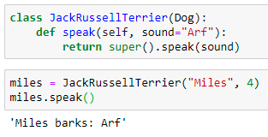
Dog Park Example – Solution (cont.)
Access the parent class from inside a method of a child class by using super():
When you call super().speak(sound) inside JackRussellTerrier, Python searches the parent class, Dog, for a .speak() method and calls it with the variable sound.
Notes:
To do this (don’t want the JackRussellTerrier class to lose any changes that might be made to the formatting of the output string of Dog.speak().) ,
you still need to define a .speak() method on the child JackRussellTerrier class. But instead of explicitly defining the output string, you need to call the Dog class’s .speak() inside of the child class’s .speak() using the same arguments that you passed to JackRussellTerrier.speak().
You can access the parent class from inside a method of a child class by using super():
When you call super().speak(sound) inside JackRussellTerrier, Python searches the parent class, Dog, for a .speak() method and calls it with the variable sound.

Slide 43
THANKS!
ANY QUESTIONS?

